Slide 1
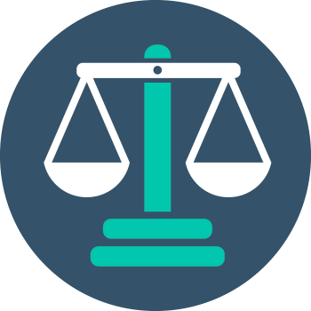


Ethics in IT
Class VIII
lab 1

Slide 2

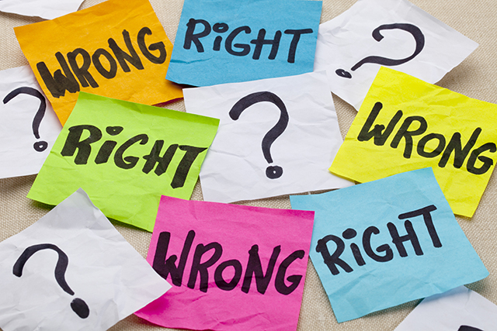

Introduction to Ethics
Ethics is all about differentiating between right and wrong

Slide 3

Correct Dicision
We have the capacity to think about our choices, so we are responsible for all our decisions and actions.

Slide 4
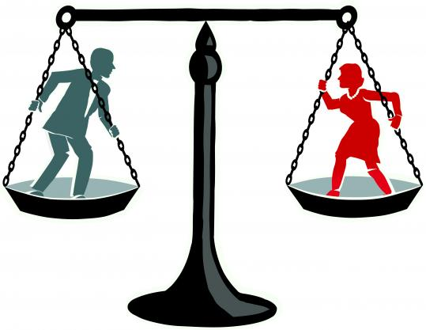
Justice vs Injustice
ethics is the study of what is wrong and what is right. Good-evil, right-wrong, virtue- vice, justice and injustice are some ethical concepts

Slide 5
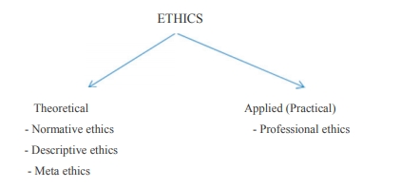
Part of Ethics

Slide 6
Stages of Ethical Education
Family
School
University
Business

Slide 7
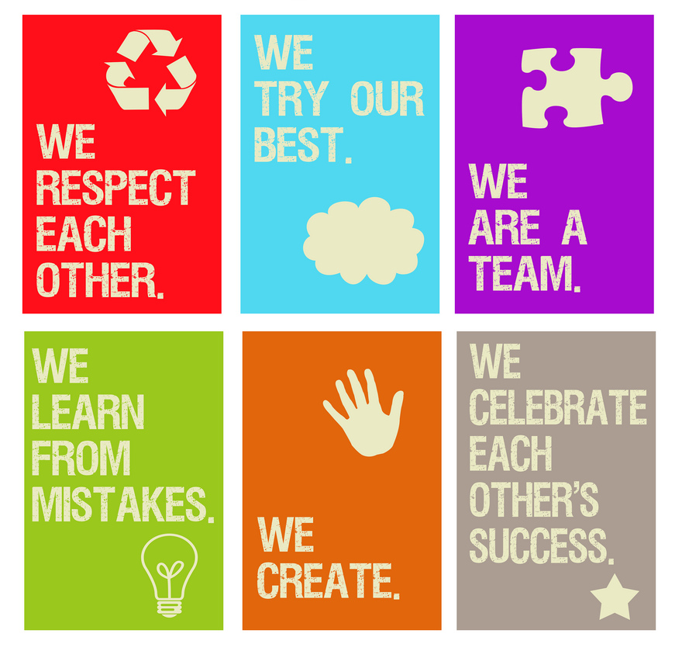
Classroom Ethics

Slide 8



